Slide 1
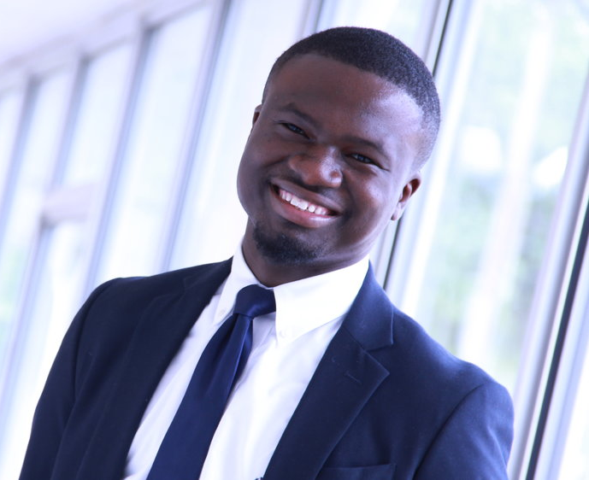
Jeff Aguy – “Humans at the Center of Our Work”
Grew up in a small village in Haiti without running water or flushable toilets and occasionally electricity.
In 2012 Jeff became the youngest CEO of a strategic planning firm in the United States at 21 years old. He has also served in a number of leadership roles including: Board Chairman, Executive Director for a Business Development Non-Profit, Director of a University Research Program and Quality Enhancement Plan Reviewer.
Chief Executive for Aguy Innovation Group, a firm committed to researching innovation, developing innovators, and implementing large scale human-centered solutions for public and private institutions.
Vice President for the Minneapolis NAACP.
Bachelor of Science degree in Industrial-Organizational Psychology with a specialization in Statistical Analysis and also holds a Six-Sigma Black Belt Certification.
Possesses a deep sense of purpose, love for community, and a passion for solving complex problems.

